Slide 1
Automatic Mitochondria Segmentation on Electron Microscopic Data
Harshit Singh & Monashree Sanil

Slide 2
Goal
Using Neural-network based architecture, perform pixel based classification (semantic segmentation) on 2D and 3D images of mitochondria.
Pre-Processing
The original data is a 3D image, comprising of 165 slices stacked in a TIF file. We used ImageJ software to convert the image into 2D slices.
Since the original size of the image is very large,
- For 2D UNet: cropped the image into several smaller patches (2D slices)
- For 3D UNet: cropped the image into 3D sub-volumes (also known as voxels).
Normalized the images.

Slide 3
Model
Metrics
We trained the models using 3D and 2D UNet architectures to perform semantic segmentation on mitochondria cell images. Idea behind using 3D UNet was to exploit the 3D spatial information from volumetric EM data.
For evaluating the performance of the model, dice coefficient was used as there was class-imbalance problem.

Slide 4
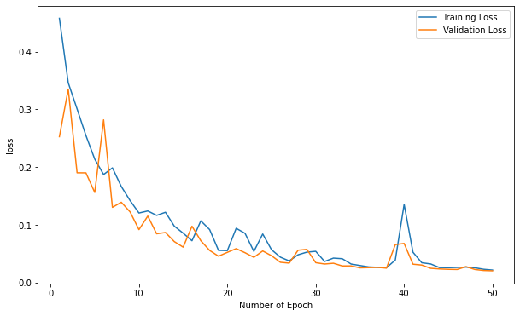
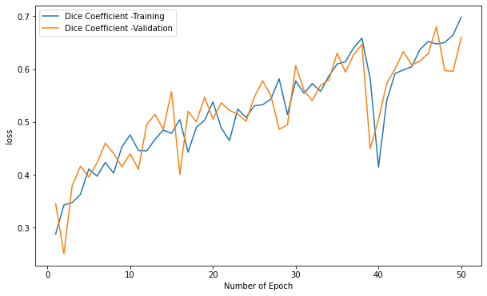
3D UNet
Training/Validation Loss vs No. of Epochs
Training/Validation Dice Coefficient Score

Slide 5
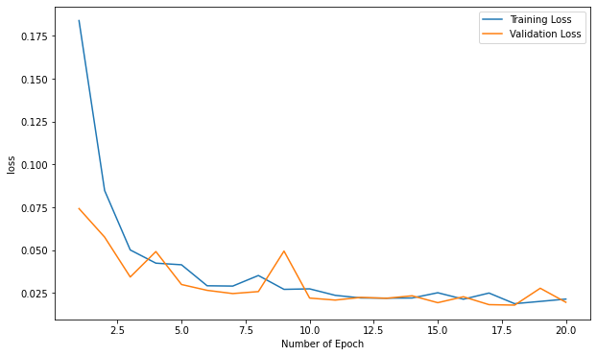
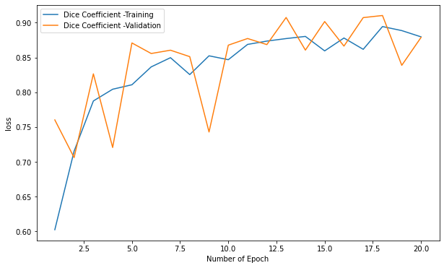
2D UNet
Training/Validation Loss vs No. of Epochs
Training/Validation Dice Coefficient Score

Slide 6
Results and Takeaways
3D UNet Model:
Achieved dice coefficient score of ~0.66 after training the model for ~50 epochs.
We observed that for this dataset, loss decreased slowly and it took larger number of epochs for the model to learn the optimal parameters.
We also explored work done by other researchers in this area and found that performance of the model improved further when it was trained for about ~100 epochs.
The 3D image was converted into several voxels of size 64x64x64. The performance could be improved with larger voxel sizes, but due to hardware constraints we weren’t able to do so.
2D UNet Model:
Achieved dice coefficient score of ~0.87 after training the model for ~10 epochs.
The 2D image was converted into several patches of size 256x256.
There are can be a lot of factors that can be attributed to the performance of 2D UNet model being better than 3D UNet. One possible reason can be lower voxel sizes.

